Slide 1

Parking Guidance System Solution

Slide 2
About Us
Mr.Nguyễn Đức Lợi
Supervisor
Trần Nguyễn Minh Trung
Firmware: System architecture & interface protocol
Software: Android Application
Bùi Phú Hiệp
Nguyễn Đỗ Phương Huy
Hardware: Design & Implement
Software: Web Server
Hardware: Implement
Testing: Design and Execute

Slide 3
Outline
Problem
Solution
Introduction

Slide 4
Outline
Problem
Solution
Introduction
How the System Works
Web Service
Hardware
Firmware & Software Implement
Implementation

Slide 5
Outline
Problem
Solution
Introduction
How the System Works
Web Service
Hardware
Firmware & Software Implement
Implementation
Advantages & Disadvantages
Future Plan
Demo
Conclusion

Slide 6
Introduction
Problem
Solution

Slide 7
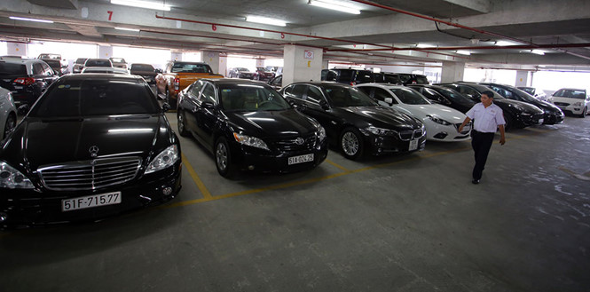
Problem

Slide 8

Problem

Slide 9
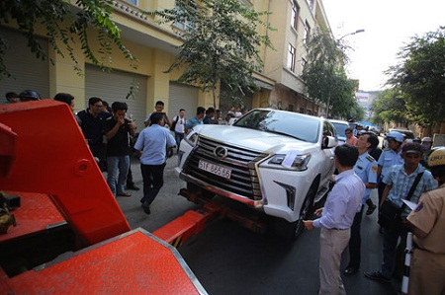
Problem

Slide 10
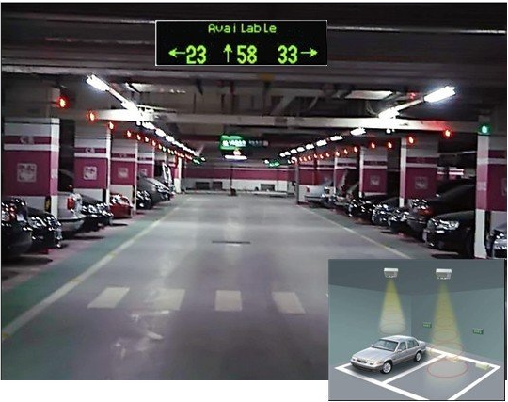

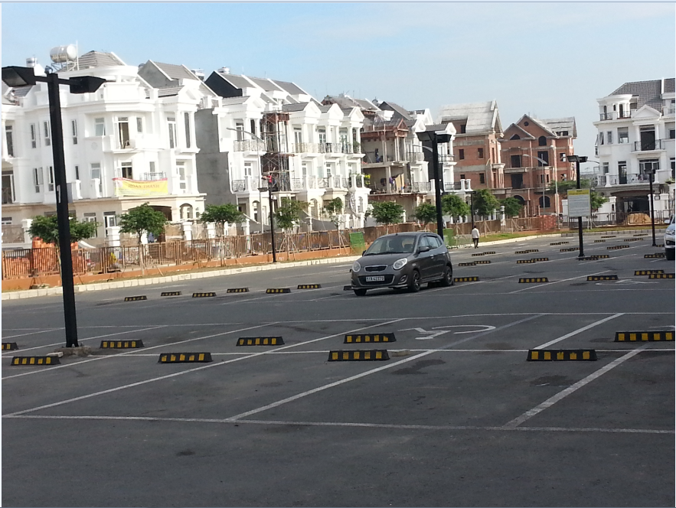
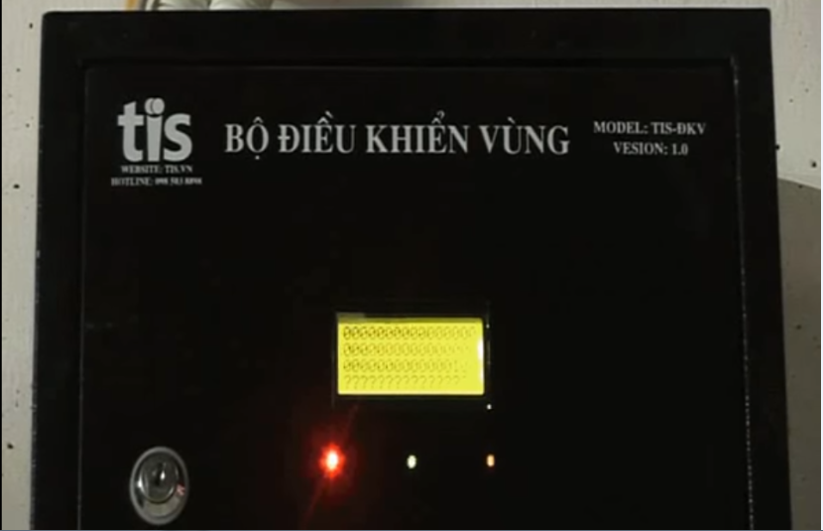
Problem
Notes:
6 bãi xe, dự kiến 3000 chỗ mỗi bãi

Slide 11
Problem
Complicated planning of wired system.
Incompatible with outdoor system.
Limited information provided to drivers.

Slide 12
Solution

Slide 13
Implementation
How the System Works
Web Service
Hardware
Firmware & Software Implement

Slide 14

How the system works

Slide 15

How the system works

Slide 16

How the system works

Slide 17

How the system works

Slide 18
How the system works
Collect Data

Slide 19
How the system works
Update Information

Slide 20

How the system works
Send data

Slide 21
How the system works
Receive command

Slide 22
How the system works
Update Status

Slide 23
How the system works

Slide 24
How the system works
Collect Data

Slide 25

How the system works
Get Information

Slide 26
How the system works
Issue a command

Slide 27
How the system works
Send Command

Slide 28
How the system works

Slide 29
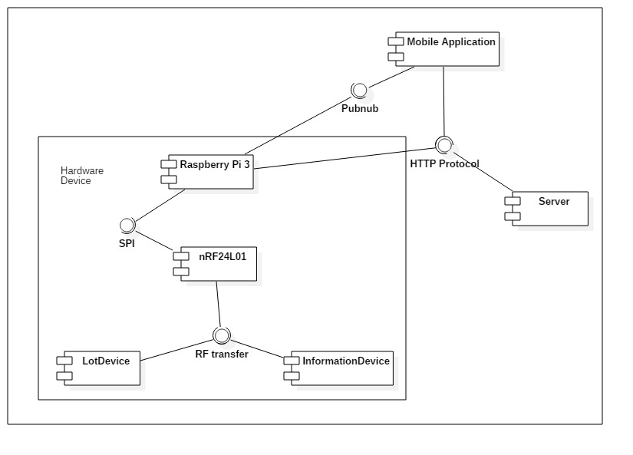
How the system works

Slide 30
Web Server

Slide 31
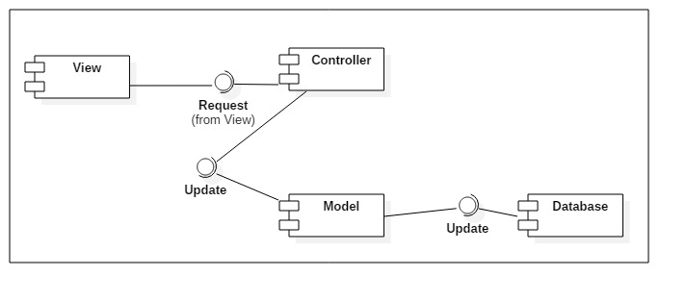
Web Server

Slide 32


Web Service
Database
Web server

Slide 33
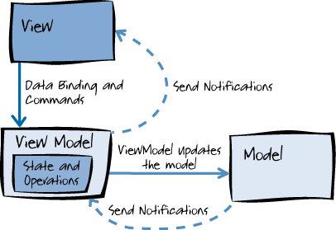
Web Service

Slide 34
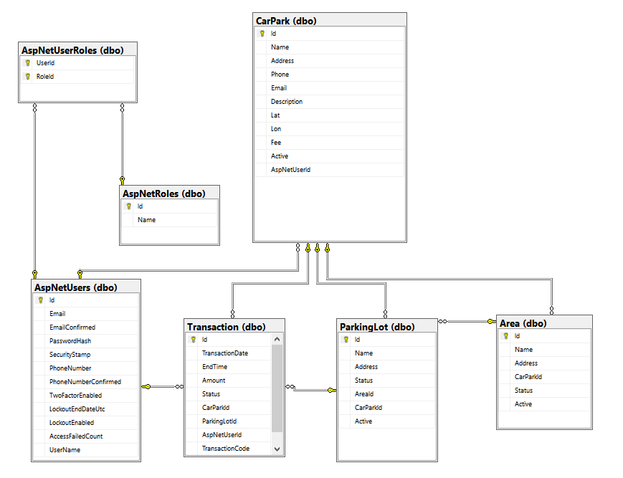
Web Service

Slide 35
Web Server

Slide 36

Web Server

Slide 37
Hardware

Slide 38
Hardware

Slide 39
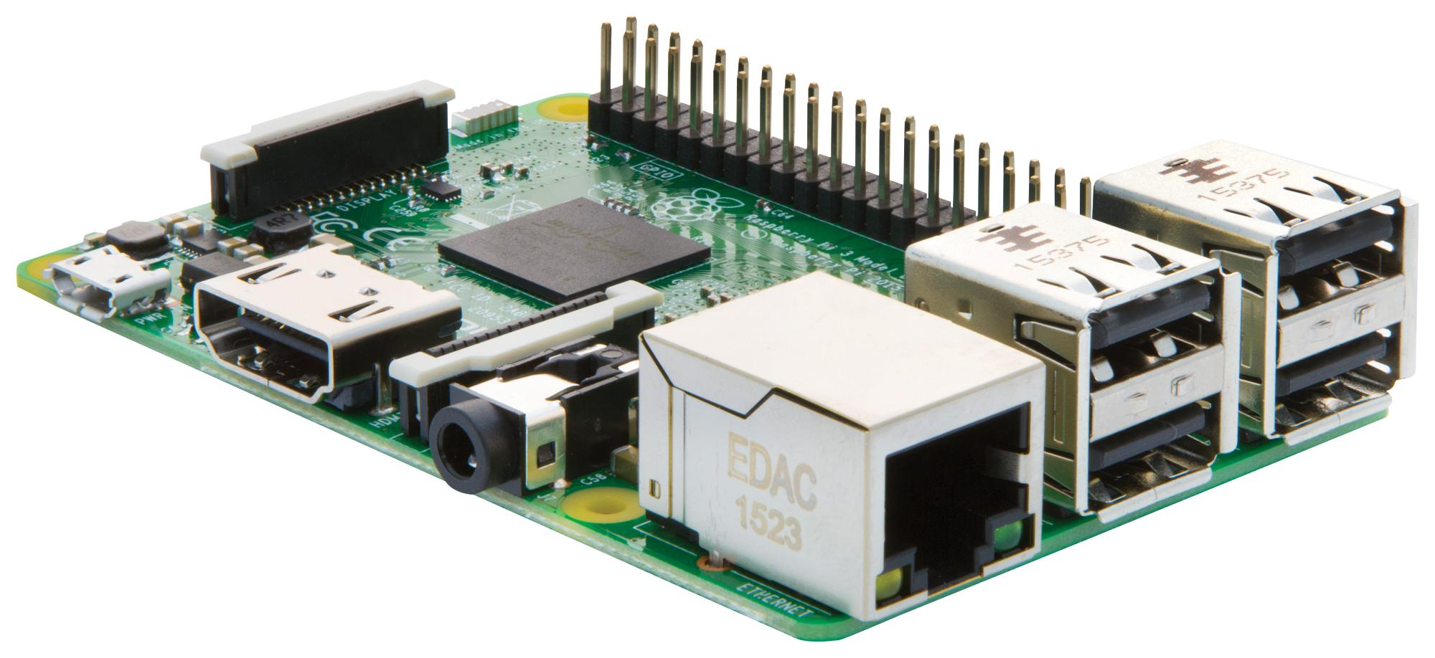
Hardware
Raspberry Pi 3

Slide 40
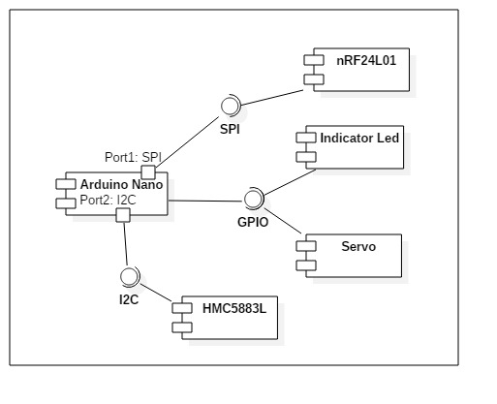
Hardware
Lot Node

Slide 41
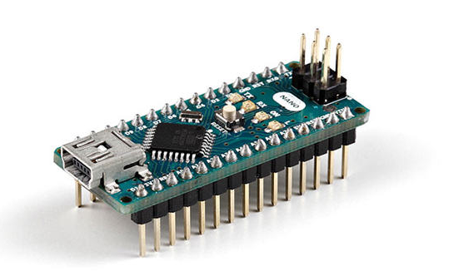
Hardware
Lot Node
Arduino Nano
Arduino Nano

Slide 42
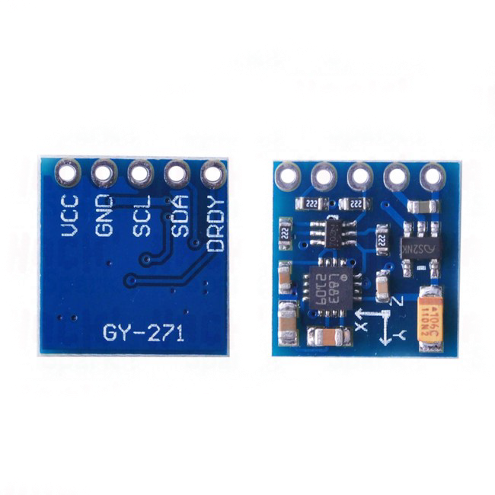
Hardware
Lot Node
Arduino Nano
Arduino Nano
HMC5883L
HMC5883L
Notes:
Đo từ trường trái đất

Slide 43
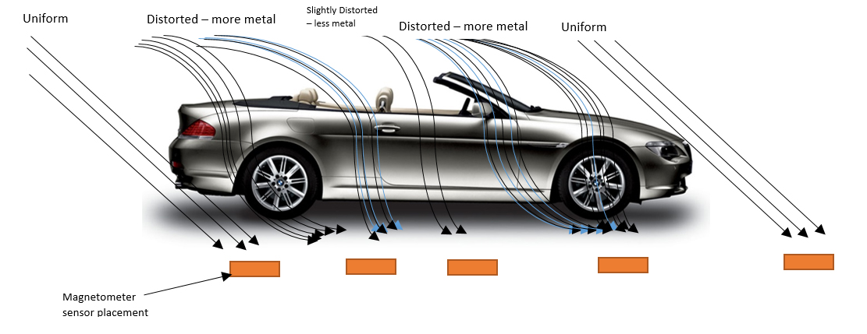
Hardware
Lot Node
Arduino Nano
Arduino Nano
HMC5883L
HMC5883L
Earth’s magnetic field lines distorted by ferrous metal of the car
Notes:
Before the vehicle approaches the sensor, the sensor would experience uniform field.
However as the vehicle passes over the sensor it distorts the earth’s magnetic field
The sensor captures this variable pattern as the vehicle passes through.

Slide 44
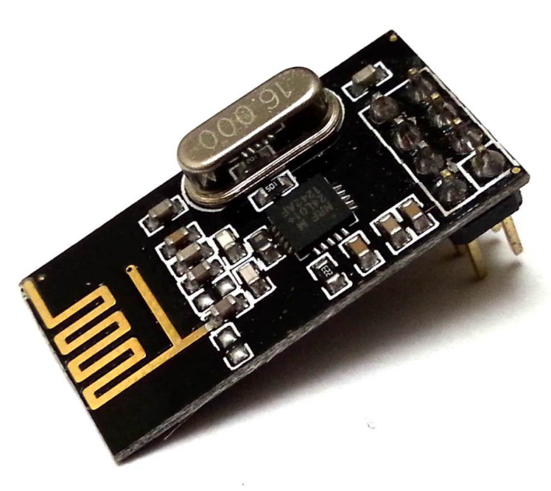
Hardware
Lot Node
Arduino Nano
Arduino Nano
HMC5883L
HMC5883L
nRF24L01+
nRF24L01+

Slide 45
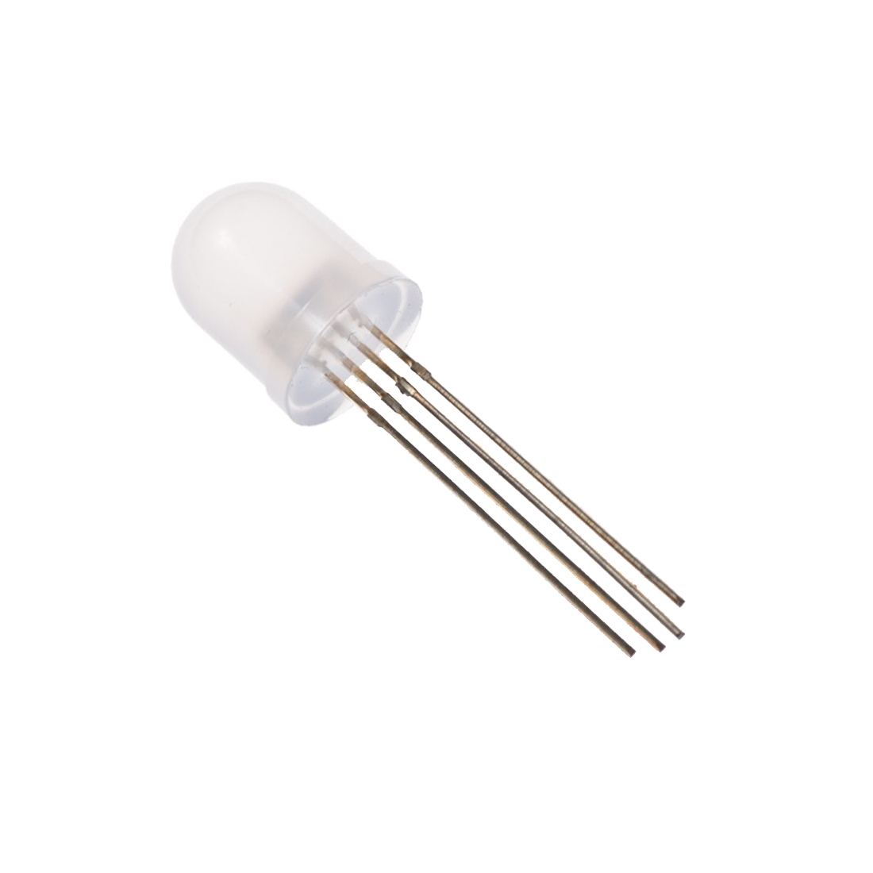
Hardware
Lot Node
Arduino Nano
Arduino Nano
HMC5883L
HMC5883L
nRF24L01+
nRF24L01+
Led RGB
Led RGB

Slide 46
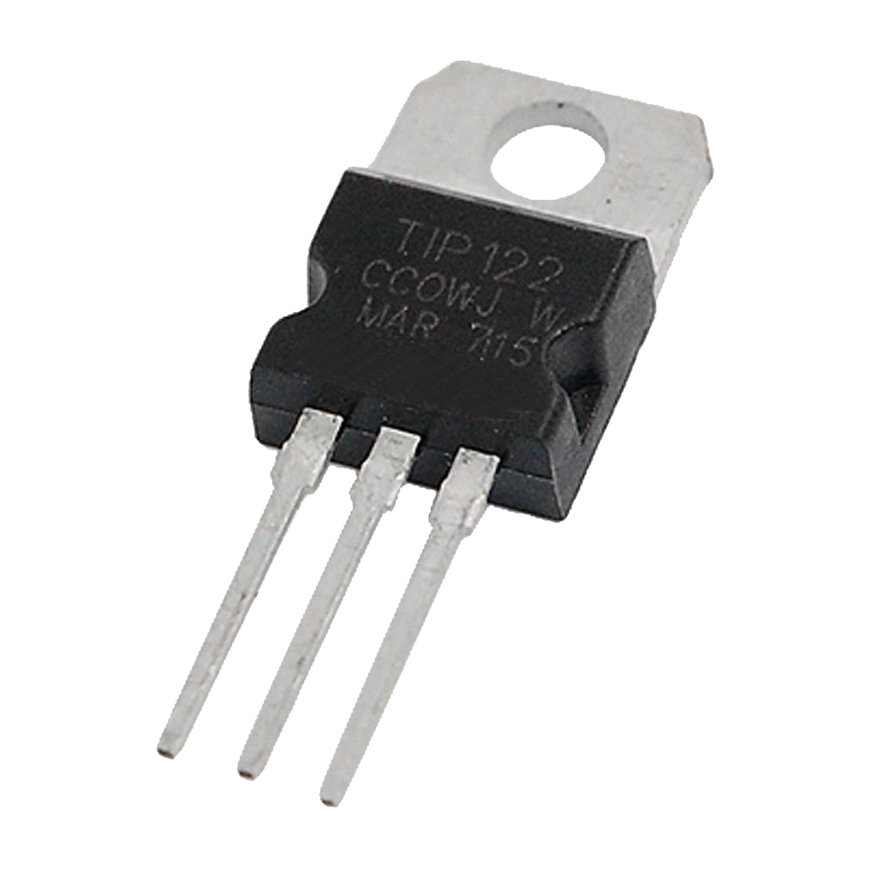
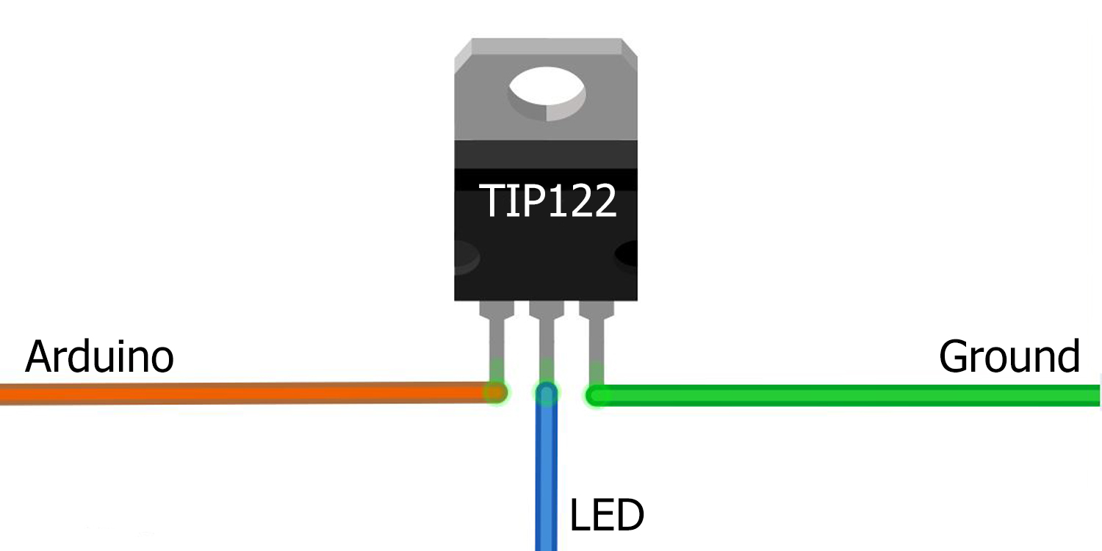
Hardware
Lot Node
Arduino Nano
Arduino Nano
HMC5883L
HMC5883L
nRF24L01+
nRF24L01+
Led RGB
Led RGB
TIP122
Notes:
1: Base - Arduino
2: Collector - Led GND 3: Emitter - GND

Slide 47
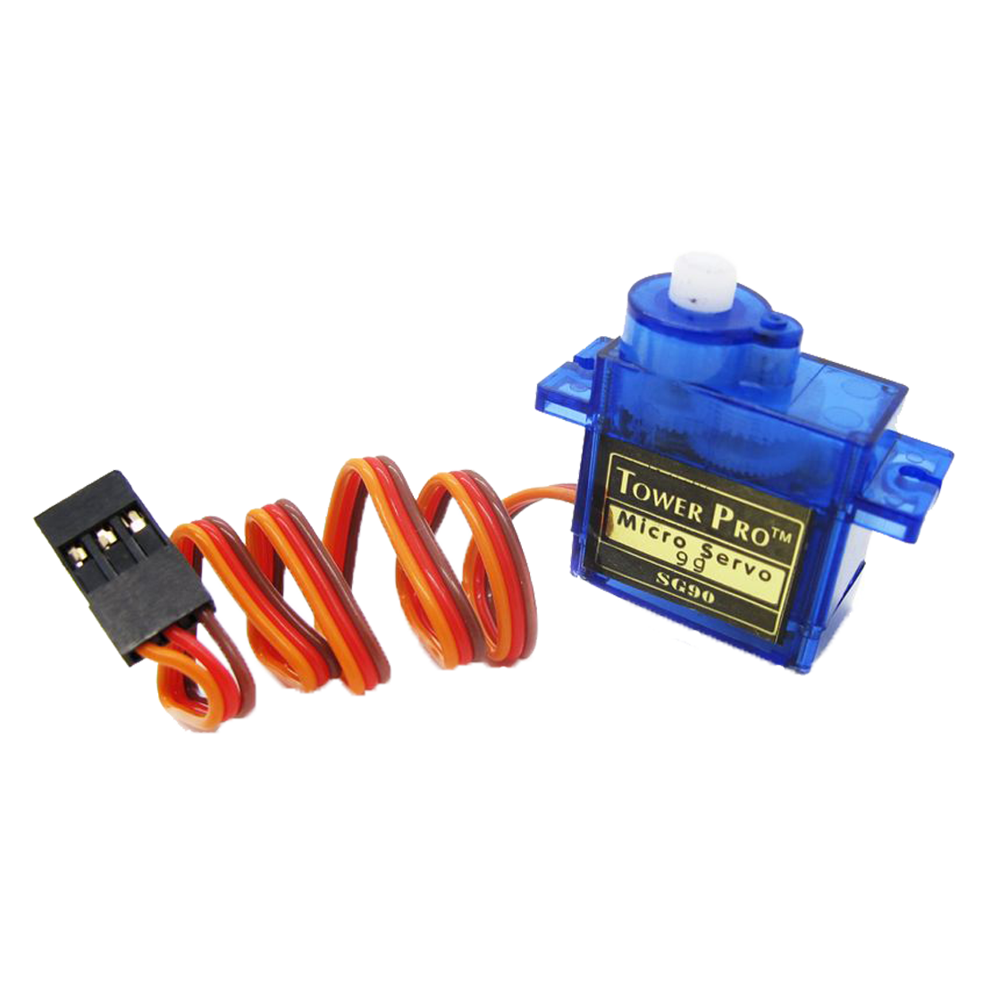
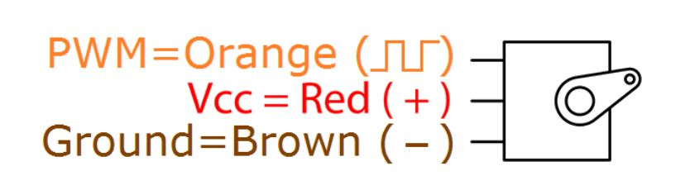
Hardware
Lot Node
Arduino Nano
Arduino Nano
HMC5883L
HMC5883L
nRF24L01+
nRF24L01+
Led RGB
Servo Motor

Slide 48
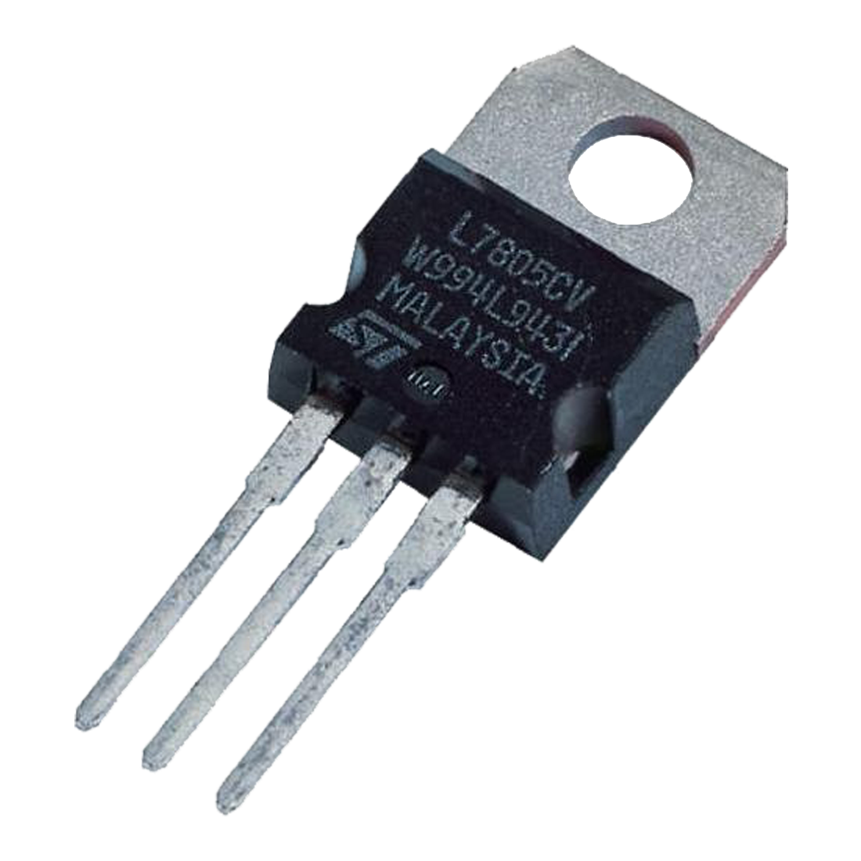
Hardware
Lot Node
Arduino Nano
Arduino Nano
HMC5883L
HMC5883L
nRF24L01+
nRF24L01+
Led RGB
Servo Motor
LM7805
Notes:
1: Input
2: GND
3: Output

Slide 49
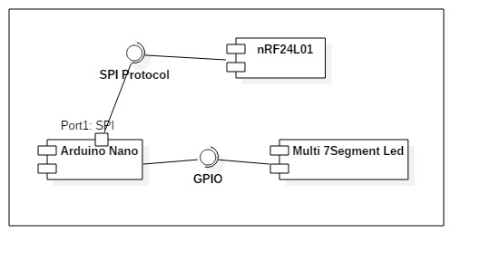
Hardware
Sign Node

Slide 50
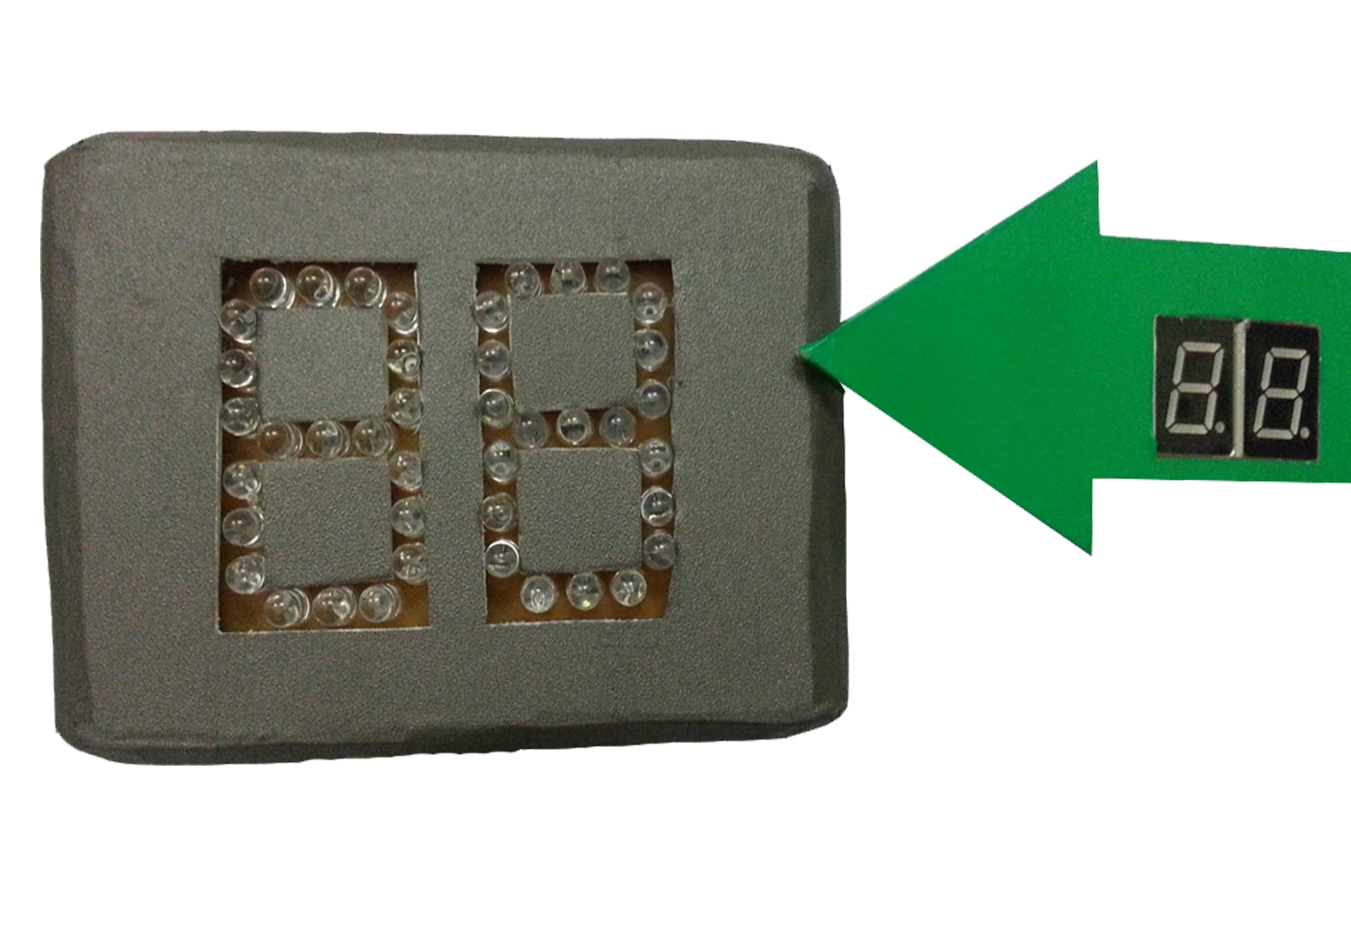
Hardware
Sign Node
Arduino Nano
nRF24L01+
7-segment LED

Slide 51
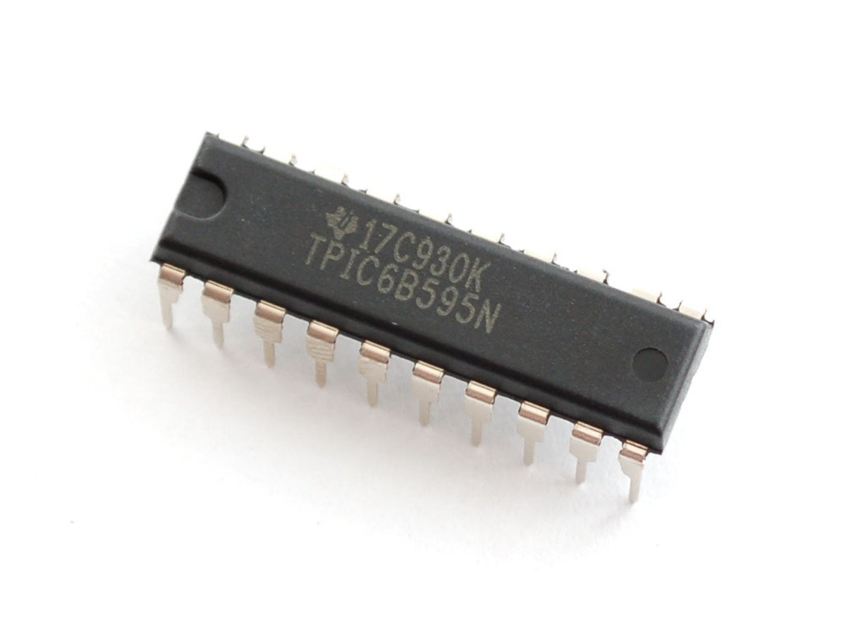
Hardware
Sign Node
Arduino Nano
nRF24L01+
7-segment LED
TPIC6B595N
Notes:
high-voltage medium-current power 8-bit shift register designed for use in systems that require relatively high load power.
150 mA per channel

Slide 52
Implement Firmware

Slide 53
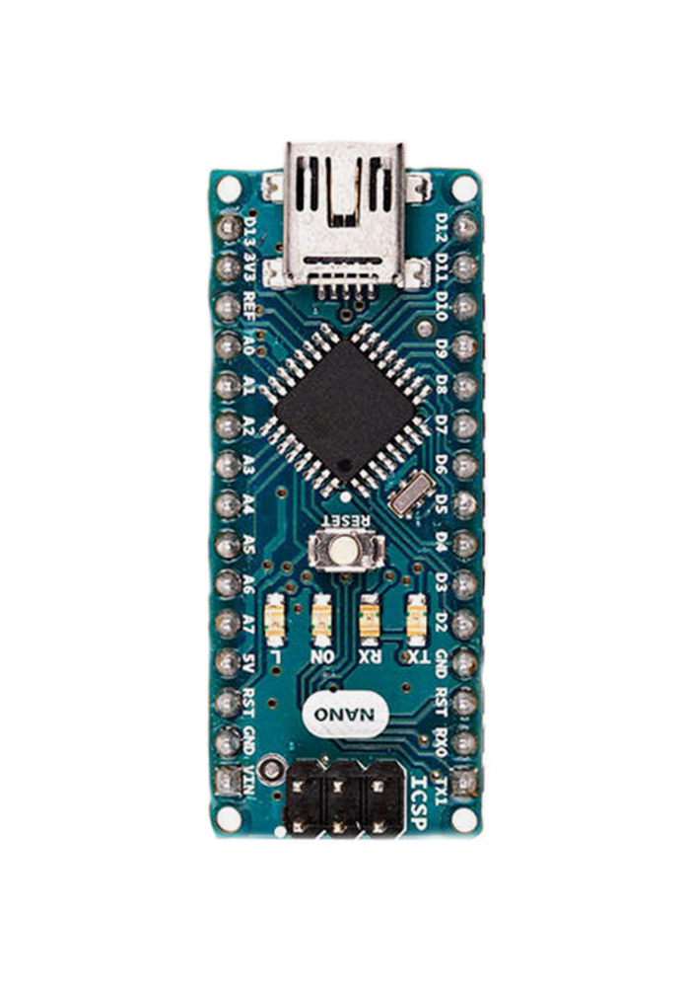

Implement Firmware
Lot Node
D13
D12
SPI
D11
RF24
CRC24
RFUtil
nRF24L01+
D8
D7

Slide 54
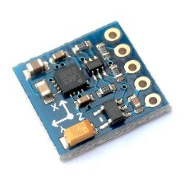
Implement Firmware
Lot Node
nRF24L01+
Wire
HMC5883L
HMC5883L
A4
A5
I²C

Slide 55
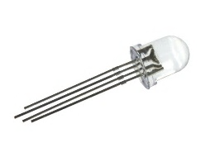
Implement Firmware
Lot Node
nRF24L01+
HMC5883L
D6
RGBLED
D5
LED RGB
D3
TIP122

Slide 56
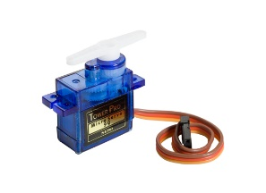
Implement Firmware
Lot Node
nRF24L01+
HMC5883L
LED RGB
D4
Servo
Servo

Slide 57
Implement Firmware
Start

Slide 58
Implement Firmware
Start
Init components

Slide 59
Implement Firmware
Start
Init components
While(true)

Slide 60
Implement Firmware
Start
Init components
While(true)
Get magnetometer data and update status if necessary

Slide 61
Implement Firmware
Start
Init components
While(true)
Get magnetometer data and update status if necessary
Get RF payload and perform action if necessary

Slide 62
Implement Firmware
Start
Init components
While(true)
Get magnetometer data and update status if necessary
Get RF payload and perform action if necessary

Slide 63
Implement Firmware

Slide 64
Implement Firmware
Sign Node
D13
D12
SPI
D11
RF24
CRC24
RFUtil
nRF24L01+
D8
D7

Slide 65
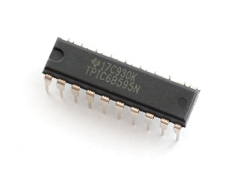
Implement Firmware
Sign Node
nRF24L01+
SEVEN_SEGMENT
TPIC6B595
D5
D4
D3
5V
GND

Slide 66
Implement Firmware
Start

Slide 67
Implement Firmware
Start
Init components

Slide 68
Implement Firmware
Start
Init components
While(true)
Get RF payload and perform action if necessary

Slide 69
Implement Firmware

Slide 70
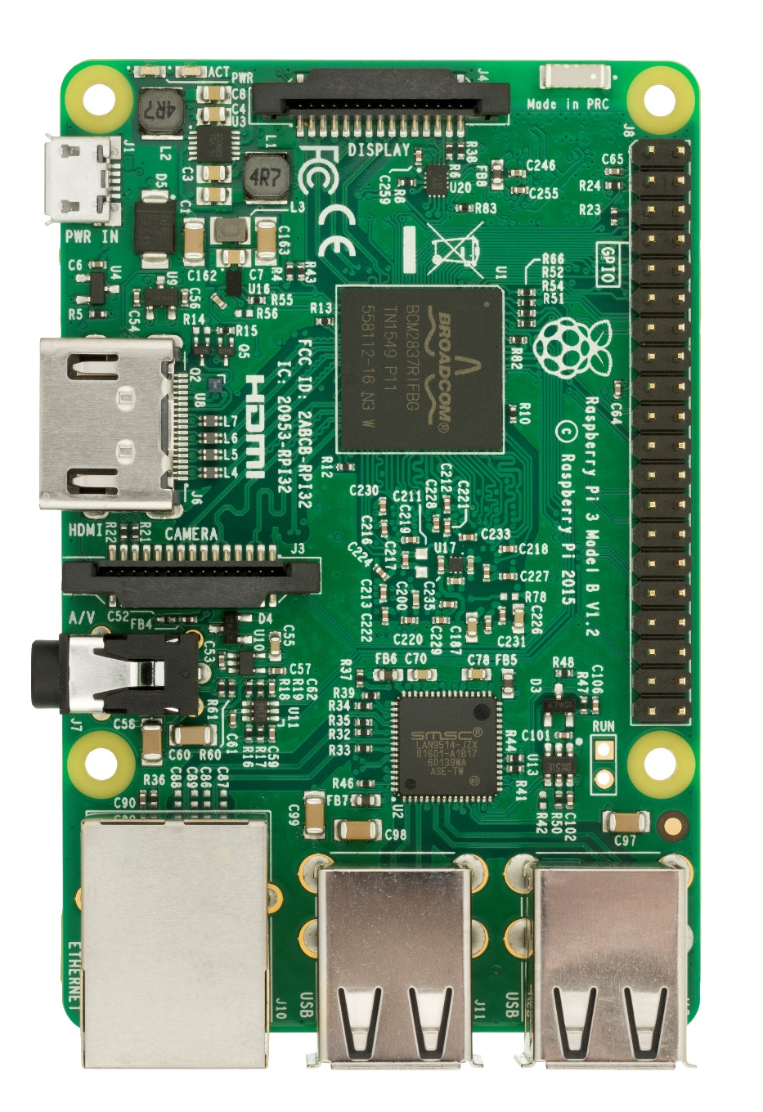
Implement Firmware
Hub Node
RF24
crc24
rf_util
Area
ParkingLot
SPI
nRF24L01+
BCM22
BCM8
3V3
MOSI
MISO
BCM11
GND

Slide 71
Implement Firmware
Hub Node
nRF24L01+
Pubnub
pubnub_meta
UserPackage
PubNub

Slide 72
Implement Firmware
Hub Node
nRF24L01+
PubNub
api_service
Api Server

Slide 73
Implement Firmware
Start

Slide 74
Implement Firmware
Start
Init component

Slide 75
Implement Firmware
Start
Init component
While(true)

Slide 76
Implement Firmware
Start
Init component
While(true)
If the request flag is false, set polling flag to true and start polling process

Slide 77
Implement Firmware
Start
Init component
While(true)
If the request flag is false, set polling flag to true and start polling process

Slide 78
Implement Firmware
Start
Init component
While(true)
While(true)
If the request flag is false, set polling flag to true and start polling process

Slide 79
Implement Firmware
Start
Init component
While(true)
While(true)
If the request flag is false, set polling flag to true and start polling process
Callback if receive request from Pubnub, set request flag to true, wait until the current polling is finished and start performing request

Slide 80
Implement Firmware
Start
Init component
While(true)
While(true)
If the request flag is false, set polling flag to true and start polling process
Callback if receive request from Pubnub, set request flag to true, wait until the current polling is finished and start performing request

Slide 81
Implement Mobile

Slide 82
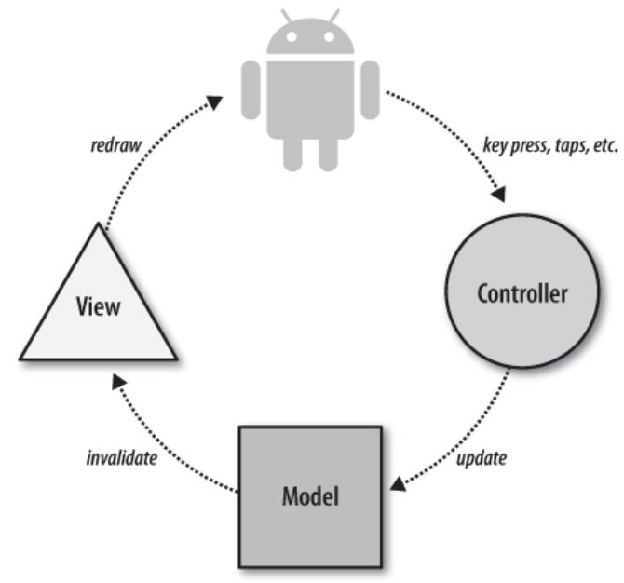
Implement Mobile

Slide 83
Implement Mobile
Activities
LoginActivity
UserActivity
ManagerActivity
TransactionActivity
…
Interfaces
Adapters
Networks
Helpers
Models

Slide 84
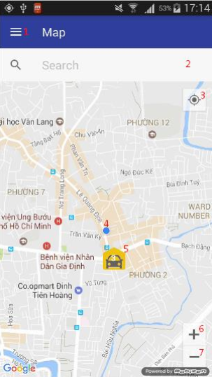
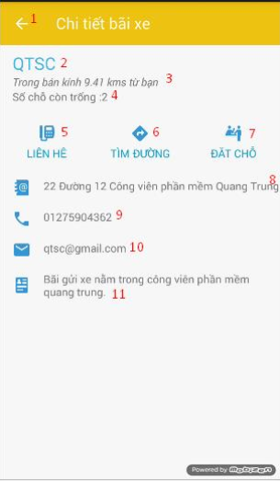
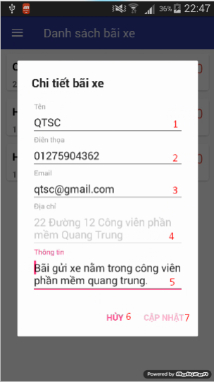
Implement Mobile

Slide 85
Conclusion
Advantages & Disadvantages
Future Plan

Slide 86
Advantage
Hardware:
Easily setup
Small devices so they were easy to maintain
Low cost
Software:
Friendly mobile interface
Scalable cloud hosting

Slide 87
Disadvantage
Hardware:
Low simulation fidelity
High RFI in testing environment
Software:
Simple algorithm, do not suitable for large car park
Only support android
Limited support for manager

Slide 88
Future Plan
Improve testing environment
Algorithm for hop, improve polling speed
Create app for multi-platform

Slide 89
Demo

